Slide 1

Online Agricultural Shop
Guided By:
Dr. Veena Jokhakar.
Submitted By:
Yashpalsingh g. Rajpurohit

Slide 2
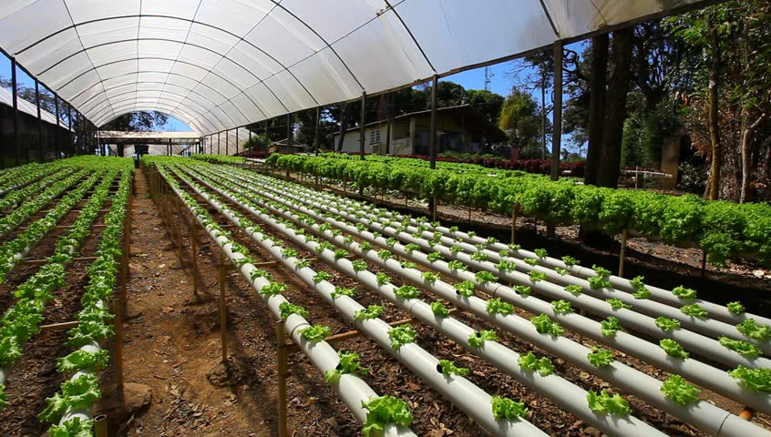
Project Purpose:
Main objective of proposed system is to design computerized system to let users buy agricultural products.
To give security to system by login and password.
Design system that is user-friendly and easy to operate.
To buy agricultural product any time.
To provide agro products to user at their doorstep.
To provide various agricultural products in rural area which are unavailable there.

Slide 3

Project Scope:
Admin
Login
Admin can add brand.
Admin can add various Categories.
Admin can add Products.
Admin can add Cities.
Admin can add States.
Logout

Slide 4
Project Scope:
User
Register
Login
View Products
Can Order AgroProducts.
Payment
Search Products
Logout

Slide 5

Project Objectives
Online Agricultural Shop is website that is used to order agro products Online.
It saves a lot of time, energy & money, moreover it provides quick & efficient services.
The main aim of the project is to create web-based software which allows user to order products related to agriculture .
Project purpose is to save time and efforts.
This website provides all types of agriculture related stuffs like fertilizers ,seeds , machinery related to agriculture and much more.

Slide 6

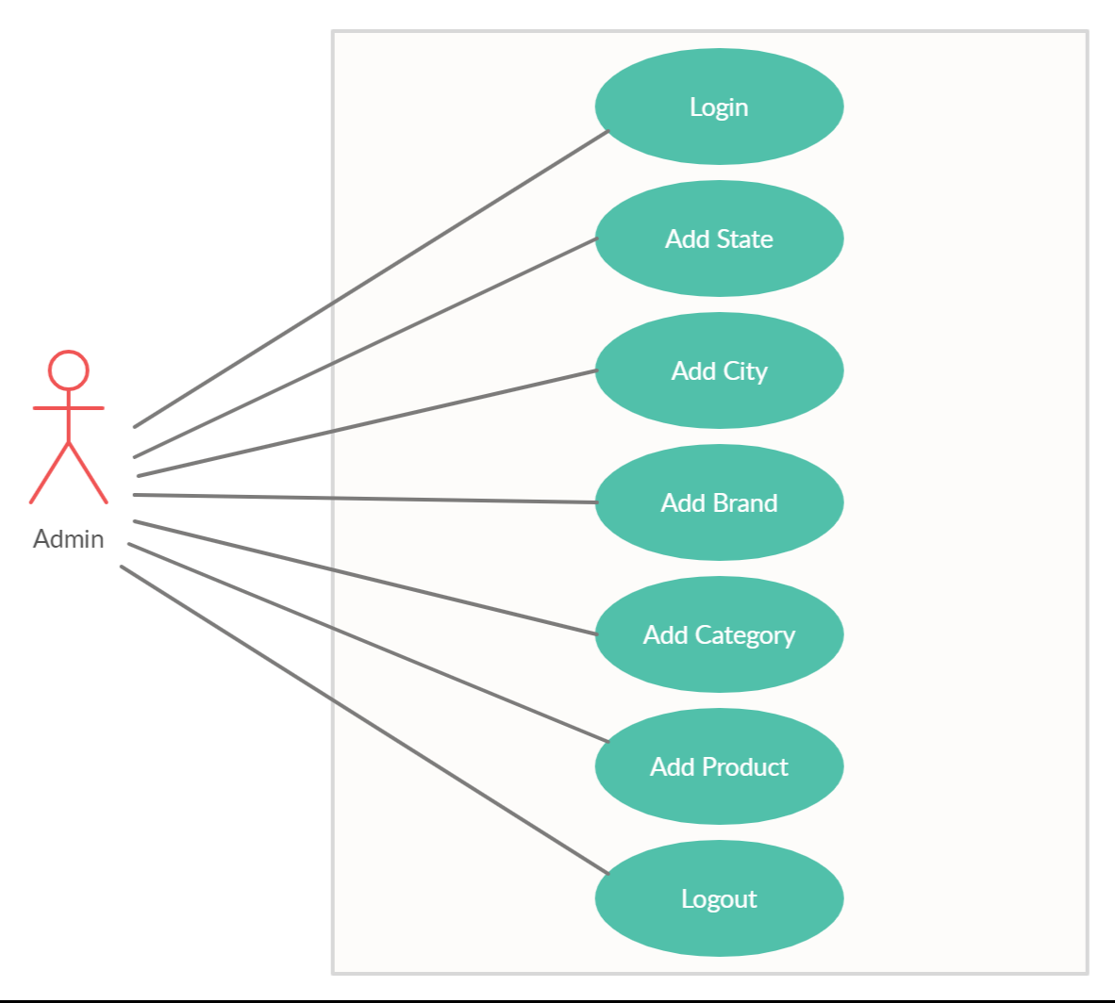
Use Case Diagram:-

Slide 7
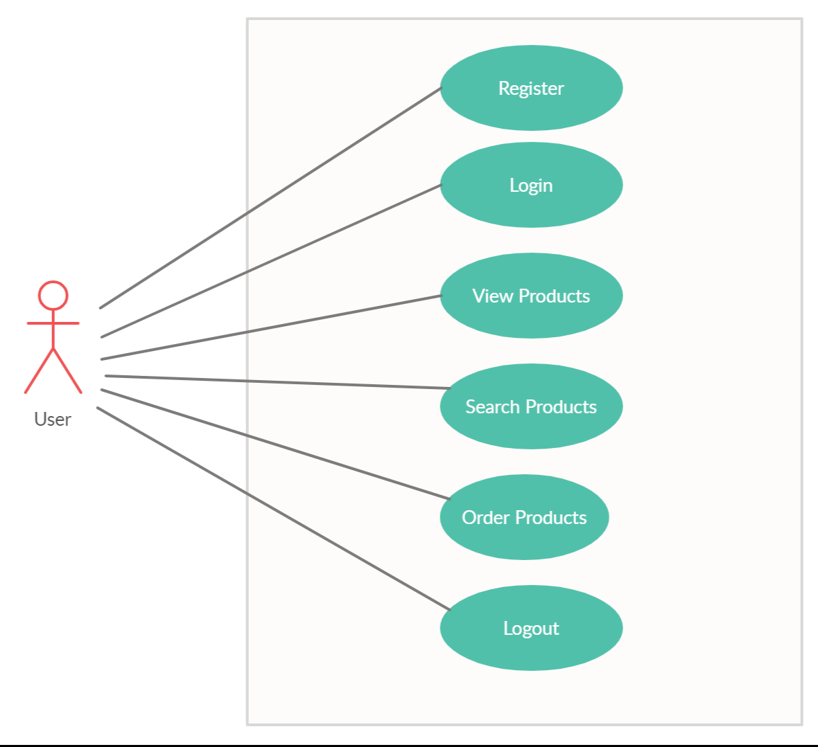
Use Case Diagram:-

Slide 8

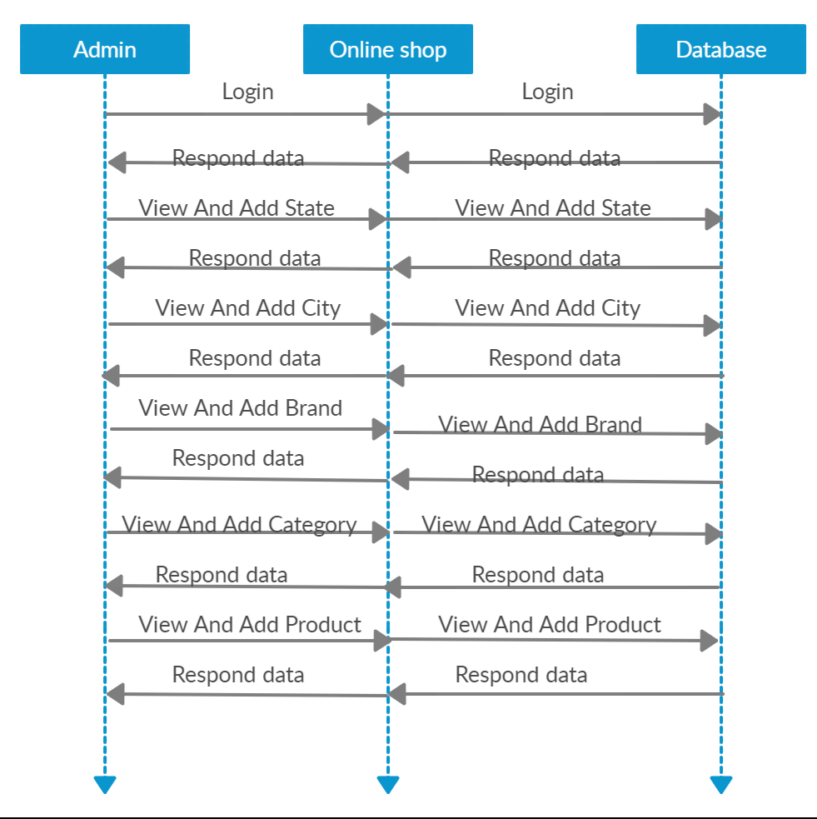

Slide 9
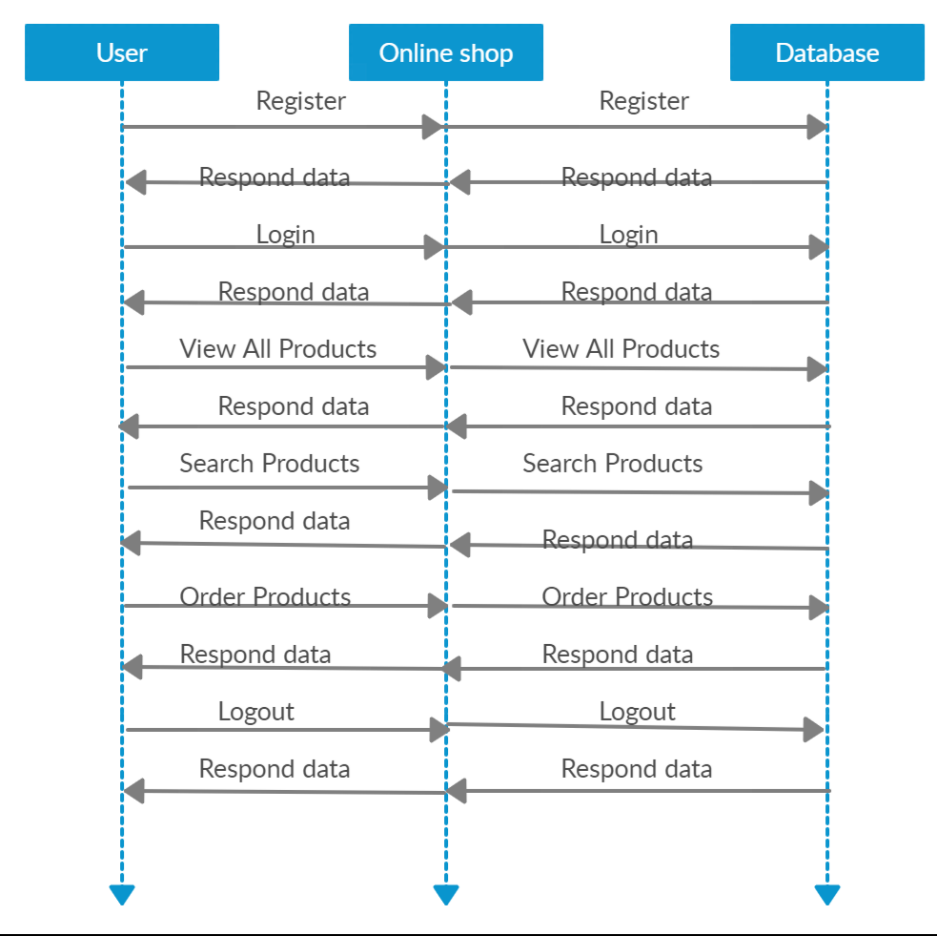

Slide 10
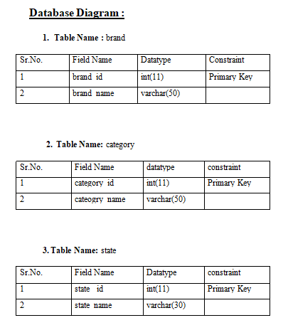

Slide 11
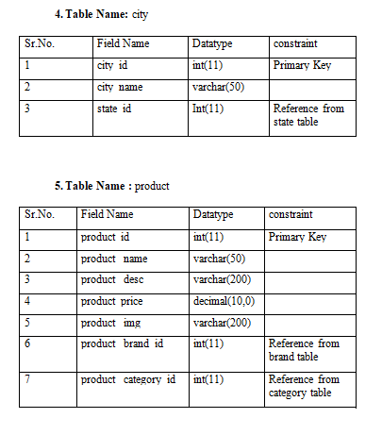

Slide 12
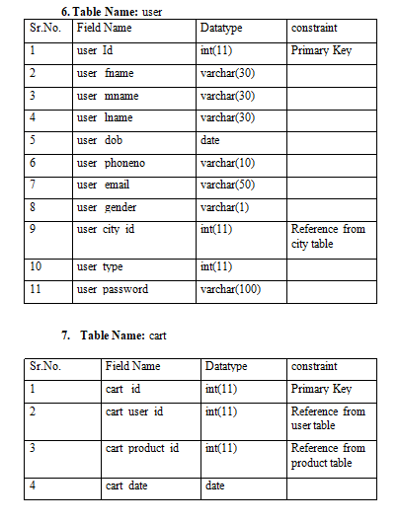

Slide 13
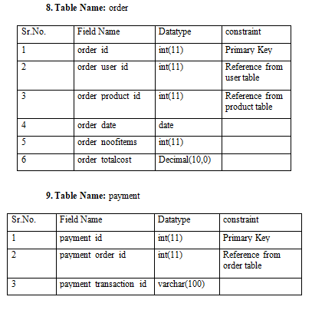

Slide 14

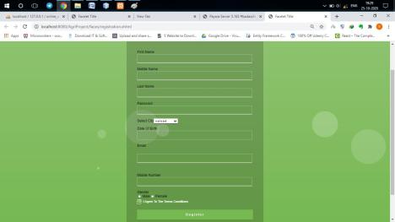
Screen Sanpshots:-

Slide 22

Future Enhancement:
Filter Based Searching
Chat Bot For Query
Guest Based Login

Slide 23
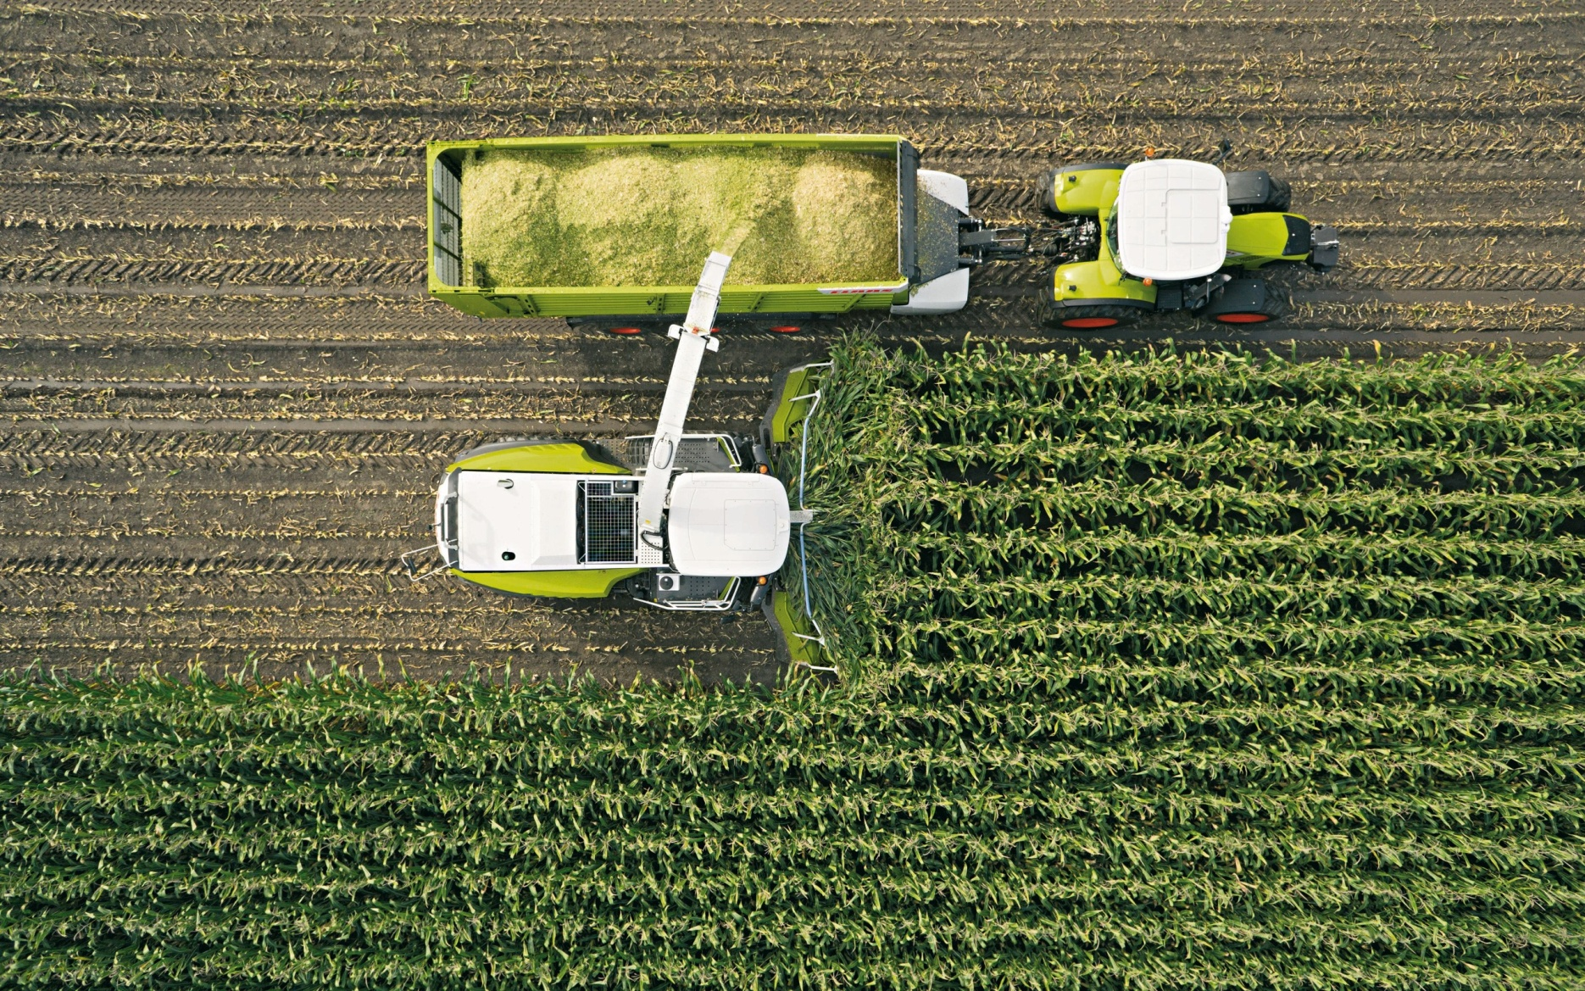

Thank You!

